Slide 1
CS5551 Advanced Software Engineering Design Patterns
Design Patterns: Elements of reusable Object-oriented Software, E. Gamma, R. Helm, R. Johnson, J. Vlissides, 1994 Pattern-Oriented Software Architecture: Applying Concurrent & Networked objects to Develop & Use Distributed Object Computing Middleware, Douglas Schmidt

Slide 2
Patterns of Learning
Successful solutions to many areas of human endeavor are deeply rooted in patterns
In fact, an important goal of education is transmitting from generation to generation
How patterns are used to learn chess vs. to develop software
Learning to develop good software is similar to learning to play good chess
Though the consequences of failure are often far less dramatic!

Slide 3
Becoming a Chess Master
First learn rules and physical requirements
e.g., names of pieces, legal movements, chess board geometry and orientation, etc.
Then learn principles
e.g., relative value of certain pieces, strategic value of center squares, power of a threat, etc.
However, to become a master of chess, one must study the games of other masters
These games contain patterns that must be understood, memorized, and applied repeatedly
There are hundreds of these patterns

Slide 4
Becoming a Software Design Master
First learn the rules
the algorithms, data structures and languages of software
Then learn the principles
structured programming, modular programming, object oriented programming, generic programming,
However, to truly master software design, one must study the designs of other masters
These designs contain must be understood, memorized, and applied repeatedly
There are hundreds of these patterns

Slide 5
Design Patterns
Design patterns represent solutions to problems that arise when developing software within a particular context
I.e., “Patterns == problem/ solution pairs in a context”
Patterns capture the static and dynamic structure and collaboration among key participants in software designs
They are particularly useful for articulating how and why to resolve non-functional requirements
Patterns facilitate reuse of successful software architectures and designs

Slide 6
Design Pattern Space [Gamma et al.]
Creational patterns
Deal with initializing and configuring classes and objects
Structural patterns
Deal with decoupling interface and implementation of classes and objects
Behavioral patterns
Deal with dynamic interactions among societies of classes and objects
E. Gamma, R. Helm, R. Johnson, J. Vlissides, Design Patterns: Elements of reusable Object-oriented Software, 1994

Slide 7
Creational Patterns
Abstract Factory
Factory for building related objects
Builder
Factory for building complex objects incrementally
Factory Method
Method in a derived class creates associates
Prototype
Factory for cloning new instances from a prototype
Singleton
Factory for a singular (sole) instance

Slide 8
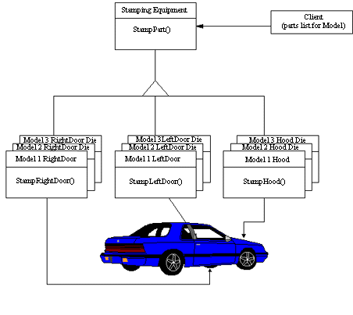
Abstract Factory
Provide an interface
for creating families
of related or dependent objects
without specifying their concrete classes.

Slide 9
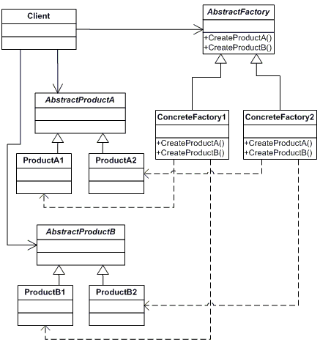
Abstract Factory
Provide an interface
for creating families
of related or dependent objects
without specifying
their concrete classes.
http://www.dofactory.com/Patterns/PatternAbstract.aspx#csharp

Slide 10
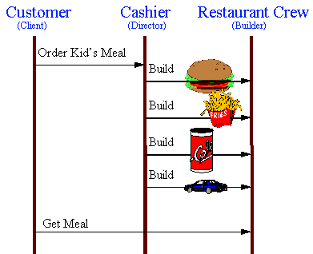
Builder
Separate the construction
of a complex object from
its representation so that
the same construction
process can create different
representations.

Slide 11
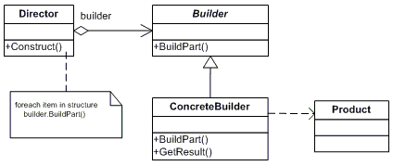
Builder
Separate the construction of a complex object from its representation so that the same construction process can create different representations.
http://www.dofactory.com/Patterns/PatternBuilder.aspx#UML

Slide 12
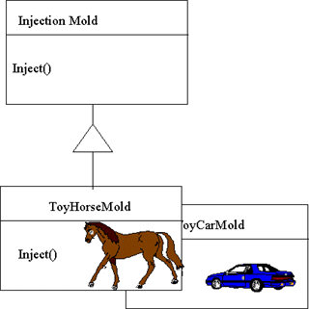
Factory Method
Define an interface for creating
an object, but let subclasses
decide which class to instantiate.
Factory Method lets a class
defer instantiation to subclasses.

Slide 13
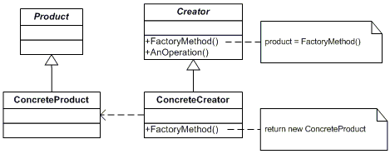
Factory Method
Define an interface for creating an object, but let subclasses decide which class to instantiate. Factory Method lets a class defer instantiation to subclasses.
http://www.dofactory.com/Patterns/PatternFactory.aspx
Notes:
http://www.dofactory.com/Patterns/PatternFactory.aspx

Slide 14
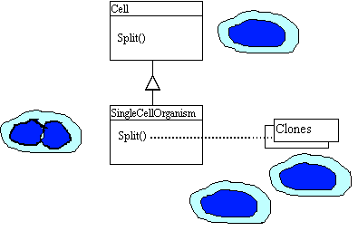
Prototype
Specify the kinds of objects
to create using a prototypical instance,
and create new objects by copying this prototype.

Slide 15
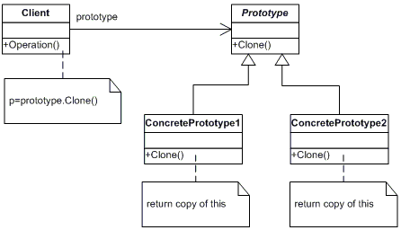
Prototype
Specify the kinds of objects to create using a prototypical instance,
and create new objects by copying this prototype.
http://www.dofactory.com/Patterns/PatternPrototype.aspx

Slide 16
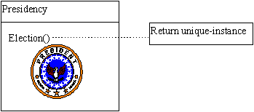
Singleton
Ensure a class has only one instance, and provide a global point of access to it.

Slide 17

Singleton
Ensure a class has only one instance, and provide a global point of access to it.
http://www.dofactory.com/Patterns/PatternSingleton.aspx

Slide 18
Structural Patterns
Adapter
Translator adapts a server interface for a client
Bridge
Abstraction for binding one of many implementations
Composite
Structure for building recursive aggregations
Decorator
Decorator extends an object transparently

Slide 19
Structural Patterns (cont’d)
Façade
Facade simplifies the interface for a subsystem
Flyweight
Many fine-grained objects shared efficiently
Proxy
One object approximates another

Slide 20
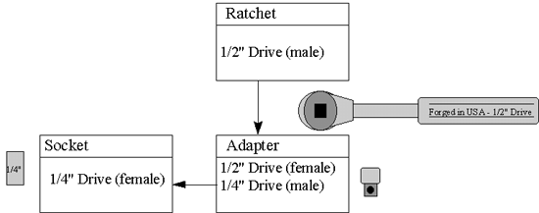
Adapter
Convert the interface of a class into another interface
clients expect. Adapter lets classes work together that
couldn't otherwise because of incompatible interfaces.

Slide 21
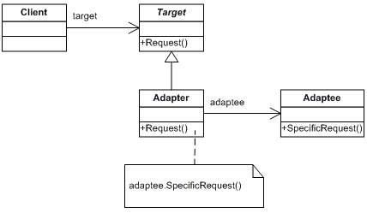
Adapter
Convert the interface of a class into another interface clients expect. Adapter lets classes work together that couldn't otherwise because of incompatible interfaces.
http://www.dofactory.com/Patterns/PatternAdapter.aspx

Slide 22
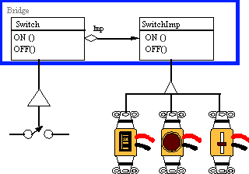
Bridge
Decouple an abstraction from its implementation
so that the two can vary independently.

Slide 23
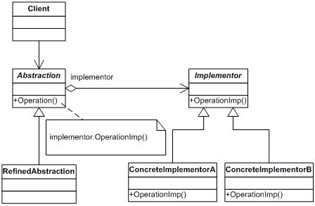
Bridge
Decouple an abstraction from its implementation so that the two can vary independently.
http://www.dofactory.com/Patterns/PatternBridge.aspx

Slide 24
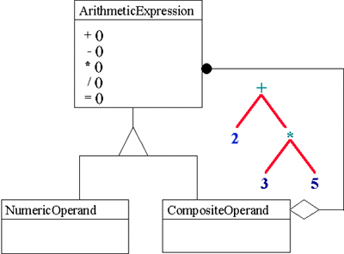
Composite
Compose objects into tree structures to represent whole-part hierarchies. Composite lets clients treat individual objects and compositions of objects uniformly.

Slide 25
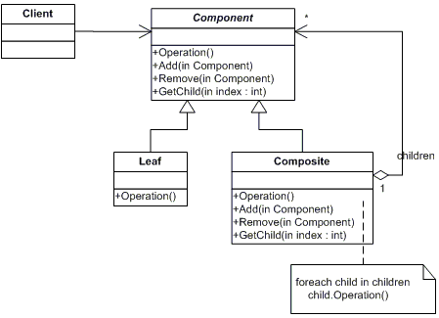
Composite
Compose objects into tree structures to represent whole-part hierarchies. Composite lets clients treat individual objects and compositions of objects uniformly.
http://www.dofactory.com/Patterns/PatternComposite.aspx

Slide 26
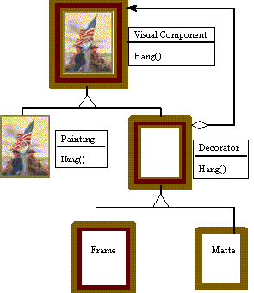
Decorator
Attach additional responsibilities
to an object dynamically. Decorators
provide a flexible alternative to subclassing
for extending functionality.

Slide 27
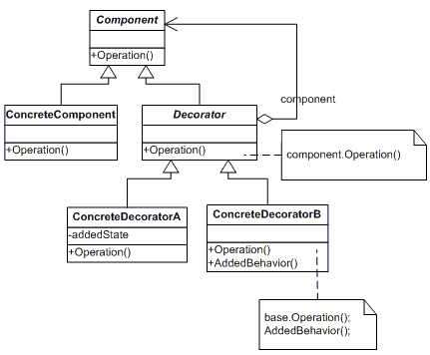
Decorator
Attach additional responsibilities
to an object dynamically. Decorators
provide a flexible alternative to subclassing
for extending functionality.
http://www.dofactory.com/Patterns/PatternDecorator.aspx

Slide 28
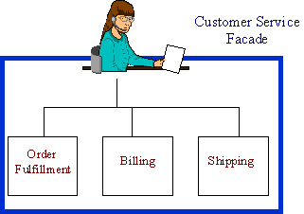
Facade
Provide a unified interface to a set of interfaces in a subsystem.
Facade defines a higher-level interface that makes the subsystem
easier to use.

Slide 29
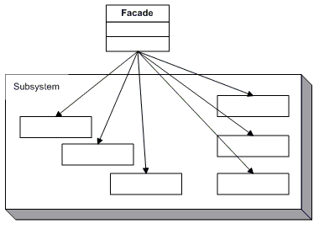
Facade
Provide a unified interface to a set of interfaces in a subsystem.
Facade defines a higher-level interface that makes the subsystem
easier to use.
http://www.dofactory.com/Patterns/PatternFacade.aspx

Slide 30
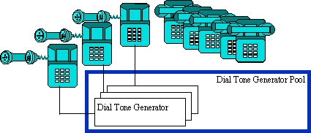
Flyweight
Use sharing to support large numbers of fine-grained objects efficiently.

Slide 31
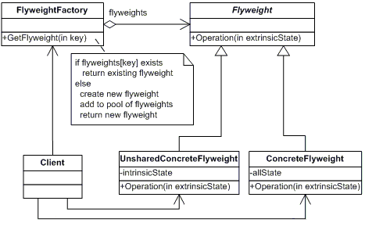
Flyweight
Use sharing to support large numbers of fine-grained objects efficiently.
http://www.dofactory.com/Patterns/PatternFlyweight.aspx

Slide 32
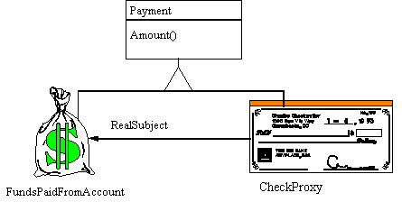
Proxy
Provide a surrogate or placeholder for another object to control access to it.

Slide 33
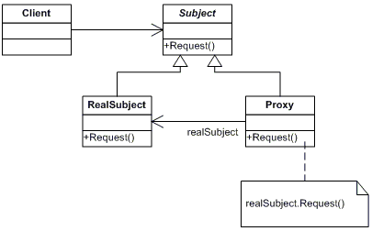
Proxy
Provide a surrogate or placeholder for another object to control access to it.
http://www.dofactory.com/Patterns/PatternProxy.aspx

Slide 34
Behavioral Patterns
Chain of Responsibility
Request delegated to the responsible service provider
Command
Request as first-class object
Interpreter
Language interpreter for a small grammar
Iterator
Aggregate elements are accessed sequentially

Slide 35
Behavioral Patterns (cont’d)
Mediator
Mediator coordinates interactions between its associates
Memento
Snapshot captures and restores object states privately
Observer
Dependents update automatically when a subject changes
State
Object whose behavior depends on its state

Slide 36
Behavioral Patterns (cont’d)
Strategy
Abstraction for selecting one of many algorithms
Template Method
Algorithm with some steps supplied by a derived class
Visitor
Operations applied to elements of an heterogeneous object structure

Slide 37
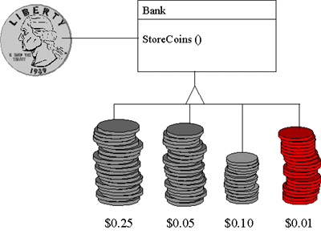
Chain of Responsibility
Avoid coupling the sender of a request to its receiver by giving more than
one object a chance to handle the request. Chain the receiving objects and
pass the request along the chain until an object handles it.

Slide 38
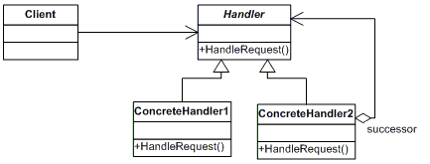
Chain of Responsibility
Avoid coupling the sender of a request to its receiver by giving more than
one object a chance to handle the request. Chain the receiving objects and
pass the request along the chain until an object handles it.
http://www.dofactory.com/Patterns/PatternChain.aspx

Slide 39
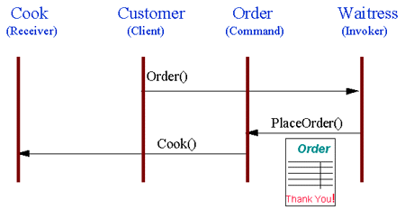
Command
Encapsulate a request as an object, thereby letting you parameterize clients with different requests, queue or log requests, and support undoable operations.

Slide 40
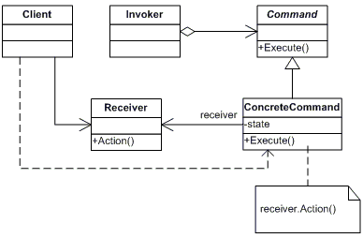
Command
Encapsulate a request as an object, thereby letting you parameterize clients with different requests, queue or log requests, and support undoable operations.
http://www.dofactory.com/Patterns/PatternCommand.aspx

Slide 41
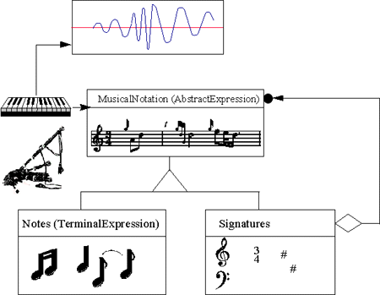
Interpreter
Given a language, define a representation for its grammar along with
an interpreter that uses the representation to interpret sentences
in the language.

Slide 42
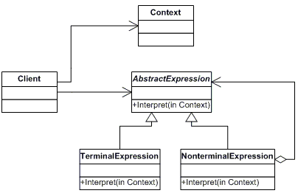
Interpreter
Given a language, define a representation for its grammar along with
an interpreter that uses the representation to interpret sentences
in the language.
http://www.dofactory.com/Patterns/PatternInterpreter.aspx

Slide 43
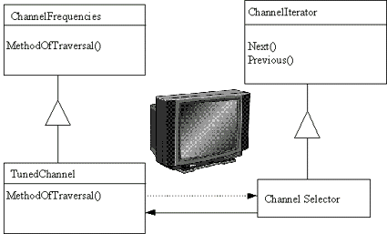
Iterator
Provide a way to access the elements of an aggregate object
sequentially without exposing its underlying representation.

Slide 44
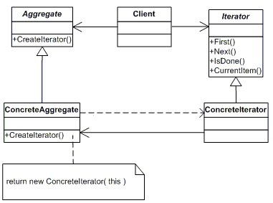
Iterator
Provide a way to access the elements of an aggregate object
sequentially without exposing its underlying representation.
http://www.dofactory.com/Patterns/PatternIterator.aspx

Slide 45
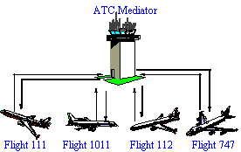
Mediator
Define an object that encapsulates how a set of objects interact.
Mediator promotes loose coupling by keeping objects from referring to
each other explicitly, and it lets you vary their interaction independently.

Slide 46
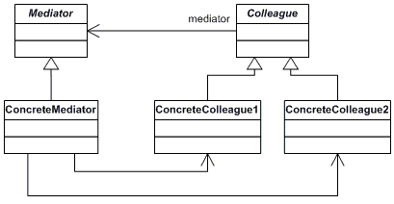
Mediator
Define an object that encapsulates how a set of objects interact.
Mediator promotes loose coupling by keeping objects from referring to
each other explicitly, and it lets you vary their interaction independently.
http://www.dofactory.com/Patterns/PatternMediator.aspx

Slide 47
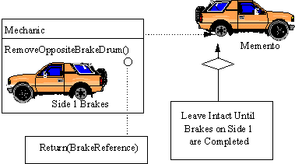
Memento
Without violating encapsulation, capture and externalize
an object's internal state so that the object can be returned to this state later.

Slide 48
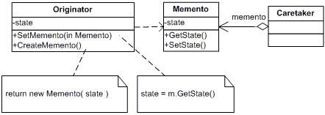
Memento
Without violating encapsulation, capture and externalize
an object's internal state so that the object can be returned to this state later.
http://www.dofactory.com/Patterns/PatternMemento.aspx

Slide 49
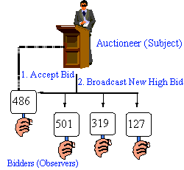
Observer
Define a one-to-many dependency between objects so that when
one object changes state, all its dependents are notified and
updated automatically.

Slide 50
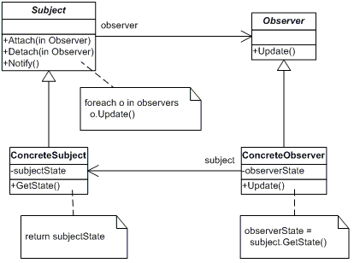
Observer
Define a one-to-many dependency between objects so that when
one object changes state, all its dependents are notified and
updated automatically.
http://www.dofactory.com/Patterns/PatternObserver.aspx

Slide 51
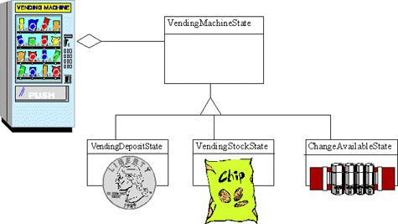
State
Allow an object to alter its behavior when its internal state changes.
The object will appear to change its class.

Slide 52
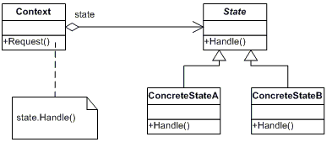
State
Allow an object to alter its behavior when its internal state changes.
The object will appear to change its class.
http://www.dofactory.com/Patterns/PatternState.aspx

Slide 53
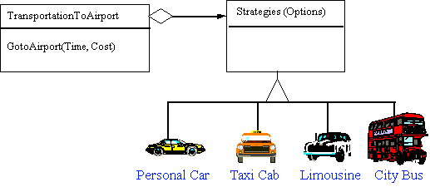
Strategy
Define a family of algorithms, encapsulate each one, and make them
interchangeable. Strategy lets the algorithm vary independently from
the clients that use it.

Slide 54
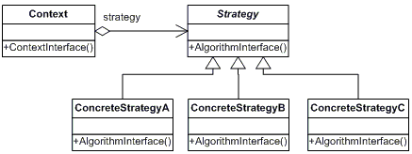
Strategy
Define a family of algorithms, encapsulate each one, and make them
interchangeable. Strategy lets the algorithm vary independently from
the clients that use it.
http://www.dofactory.com/Patterns/PatternStrategy.aspx

Slide 55
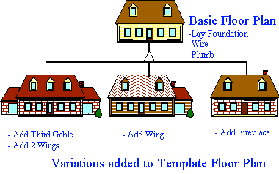
Template Method
Define the skeleton of an algorithm in an operation, deferring some steps
to client subclasses. Template Method lets subclasses redefine certain steps
of an algorithm without changing the algorithm's structure.

Slide 56
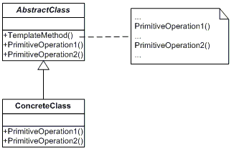
Template Method
Define the skeleton of an algorithm in an operation, deferring some steps
to client subclasses. Template Method lets subclasses redefine certain steps
of an algorithm without changing the algorithm's structure.
http://www.dofactory.com/Patterns/PatternTemplate.aspx

Slide 57
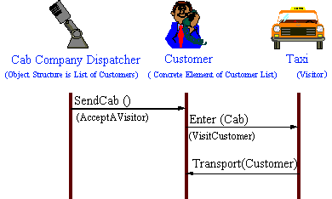
Visitor
Represent an operation to be performed on the elements of an object structure.
Visitor lets you define a new operation without changing the classes of
the elements on which it operates.

Slide 58
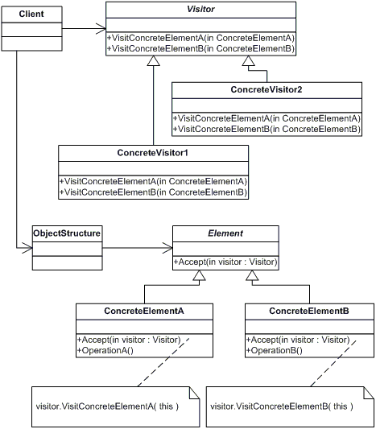
Visitor
Represent an operation to be performed on the elements of an object structure.
Visitor lets you define a new operation without changing the classes of
the elements on which it operates.
http://www.dofactory.com/Patterns/PatternVisitor.aspx

Slide 59
When to Use Patterns
Solutions to problems that recur with variations
No need for reuse if the problem only arises in one context
Solutions that require several steps
Not all problems need all steps
Patterns can be overkill if solution is simple linear set of instructions
Solutions where the solver is more interested in the existence of the solution than its complete derivation
Patterns leave out too much to be useful to someone who really wants to understand
They can be a temporary bridge, however . . .

Slide 60
What Makes it a Pattern?
A pattern must:
Solve a problem (common software problems arising within a certain context): it must be useful!
Have a context: it must describe where the solution can be used.
Recur (capture recurring structures & dynamics among software participants to facilitate reuse of successful designs): it must be relevant in other situations
Teach (generally codify expert knowledge of design constraints & “best practices”): it must provide sufficient understanding to tailor the solution.
Have a name: it must be referred to consistently.

Slide 61
Benefits of Design Patterns
Design patterns enable large-scale reuse of software architectures.
They also help document systems to enhance understanding.
Patterns explicitly capture expert knowledge and design tradeoffs, and make this expertise more widely available.
Patterns help improve developer communication.
Pattern names form a vocabulary
Patterns help ease the transition to object-oriented technology
Help resolve key design forces
Flexibility, Extensibility, Dependability, Predictability, Scalability, Efficiency

Slide 62
Drawbacks to Design Patterns
Patterns do not lead to direct code reuse.
Patterns are deceptively simple.
Teams may suffer from pattern overload.
Patterns are validated by experience and discussion rather than by automated testing.
Integrating patterns into a software development process is a human-intensive activity.

Slide 63
Suggestions for Using Patterns
Do not recast everything as a pattern.
Instead, develop strategic domain patterns and reuse existing tactical patterns.
Institutionalize rewards for developing patterns.
Directly involve pattern authors with application developers and domain experts.
Clearly document when patterns apply and do not apply.
Manage expectations carefully.

Slide 64
References
Ali Arsanjani, Chief Architect, SOA and Web services Center of Excellence, IBM, Toward a Pattern Language for Service-oriented Architecture and Integration, Part 1: Build a Service Eco-system, 13 Jul 2005
E. Gamma, R. Helm, R. Johnson, J. Vlissides, Design Patterns: Elements of reusable Object-oriented Software, 1994
Douglas Schmidt, Pattern-Oriented Software Architecture: Applying Concurrent & Networked objects to Develop & Use Distributed Object Computing Middleware
Design Patterns http://www.vincehuston.org/dp/

